Slide 1
A Multi-Level Polygonal Approximation Based Shape Encoding Framework for Automated Shape Retrieval
Sagnik Gupta
Rahul Pramanik
Under the supervision of
Prof. Sourav Saha

Slide 2
Objective
Design of a computer vision based automated model for retrieving relevant shapes against a query shape
Focus on exploring geometric properties of object’s contour.
Use of popular distance metric to compute shape similarity score between two objects.

Slide 3
Related Work
Geometric invariant moments
Zernike moments
Angular radial transform
Curvature scale space (CSS) method

Slide 4
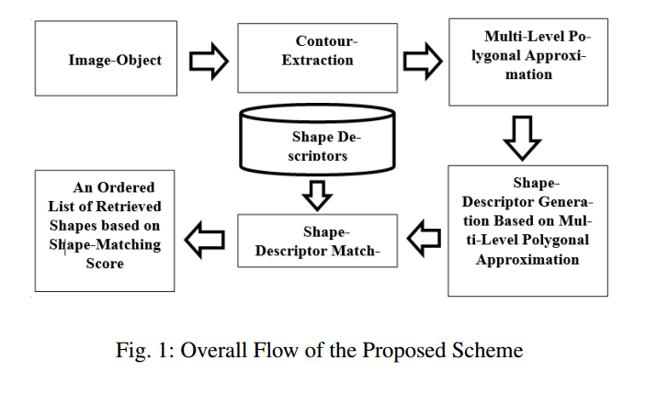
Overall Flow

Slide 5
Proposed Framework
Thick-Poly-line Approximation of Contour
Fitting Optimal-Thick-line
Greedy Best-First-Heuristic Based Curve Splitting Strategy
Polygonal Approximation
Multi-Level Polygonal Approximation
Shape-Descriptor for Multi-Level Polygonal Approximation

Slide 6
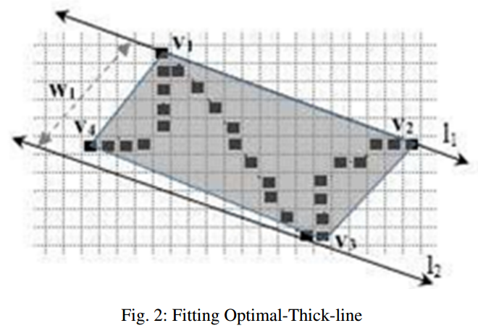
Fitting Optimal-Thick-line
Given a sequence of discrete 2-D points(D) and its Convex Hull CH(D), there exists a valid thick-line defined by a pair of support lines (l1, l2) such that (1) l1 is coincident with an edge ei of CH(D). (2) l2 is another straight line passing in parallel with l1 through a vertex vk of CH(D) which is farthest from ei. The vertex vk is termed as antipodal vertex for edge ei. The pair (vk, ei) can be termed as antipodal vertex-edge pair and the distance d(vk, ei) gives the measure of the antipodal distance for the pair (vk, ei).
(3) Determining a optimal thick-line for D is equivalent of finding an antipodal vertex-edge pair (vk, ei) for which the antipodal distance is minimum.

Slide 7
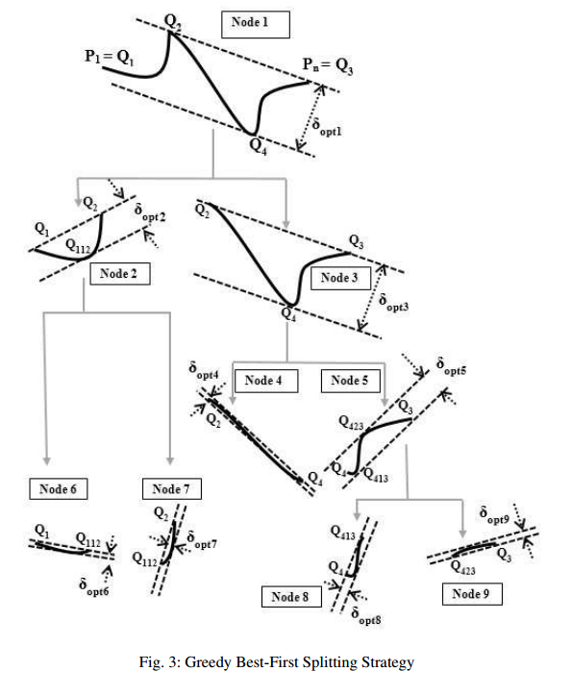
Greedy Best-First-Heuristic Based Curve Splitting Strategy
 | CostSum(P₁ , P_{N} , Q_{i} ) = Cost(P₁ , Q_{i} ) + Cost(Q_{i} , P_{N} ) CostDiff(P₁ , P_{N} , Q_{i} ) = ABS[Cost(P₁ ,Q_{i} ) - Cost(Q_{i} , P_{N} ) ] SplitCost(P₁ , P_{N} , Q_{i} )=CostSum(P₁ , P_{N} , Q_{i} ) +CostDiff(P₁ , P_{N} , Q_{i} ) PivotVertex = arg [ min {SplitCost(P₁ , P_{N} , Q_{i} )}] Q_{i}

Slide 8
Multi-Level Polygonal Approximation
In our proposed framework, users can flexibly specify number of edges to obtain a thick-edged shape approximating polygon. The accuracy of the approximation increases if users specify more number of edges for approximating polygon.
We have utilized this characteristic to approximate a shape at various approximation levels by varying number of edges of approximating polygon. It helps us to explore the evolutionary nature of the approximating polygons capturing shape-detailing characteristics at different levels

Slide 9
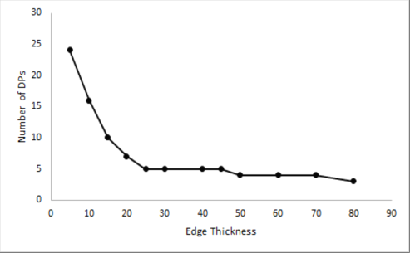
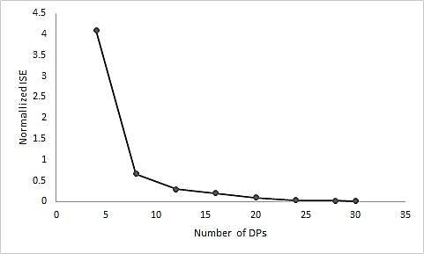
Multi-Level Polygonal Approximation
Figure 4 a. Edge Thickness Vs Number of DPs 4 b. Number of DPs Vs Error
If the number of dominant points (DP) is plotted against the error as a measure of approximation, the degree of approximation is found to increasing with the decrease in number of DPs. Fig. 4a and Fig. 4b shows the influence of number of DPs on the degree of approximation and Fig. 4b shows how thickness governs number of DPs in the proposed approximation scheme.

Slide 10
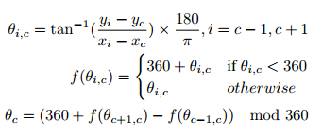

Shape-Descriptor for Multi-Level Polygonal Approximation
Step 1: The vertices of the shape-approximating polygon are indexed clockwise.
Step 2: Internal angle at each vertex is computed
.
Step : The new set of computed angles at previous step are sorted in ascending order.

Slide 11
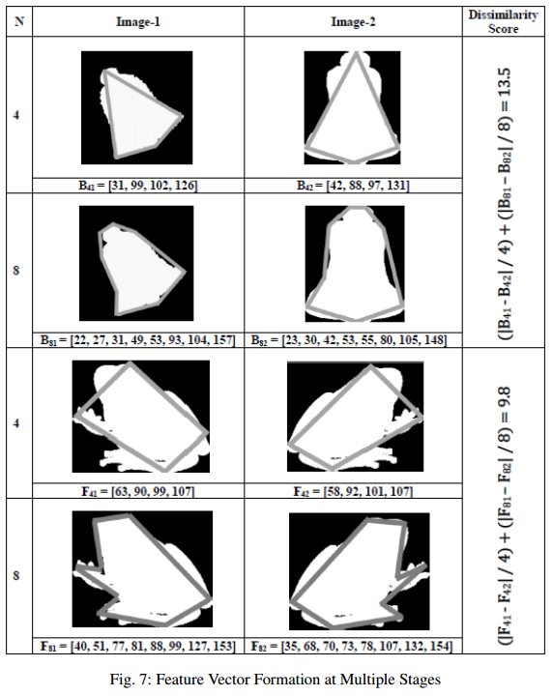
Feature Vector Formation

Slide 12
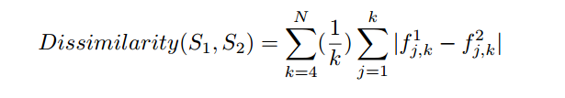
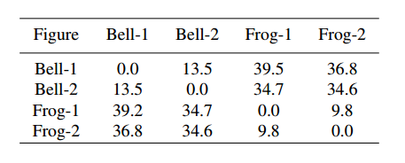
SHAPE DISSIMILARITY SCORE MATRIX

Slide 13
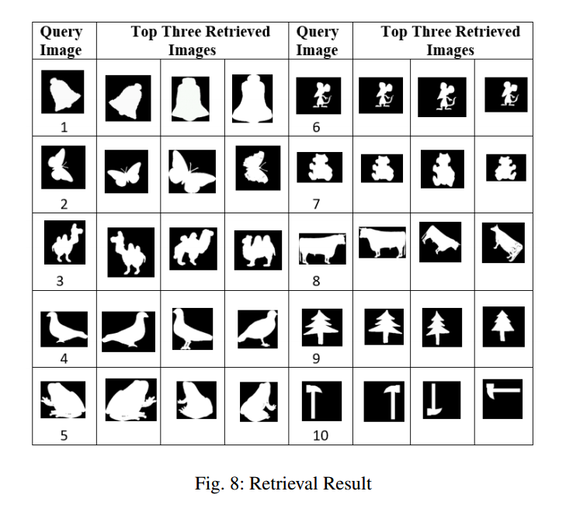
Experimental results and discussion

Slide 14
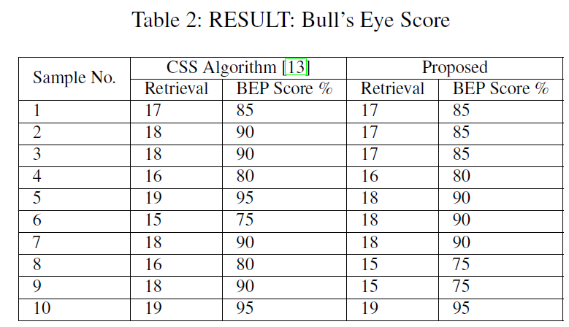
Experimental results and discussion

Slide 15
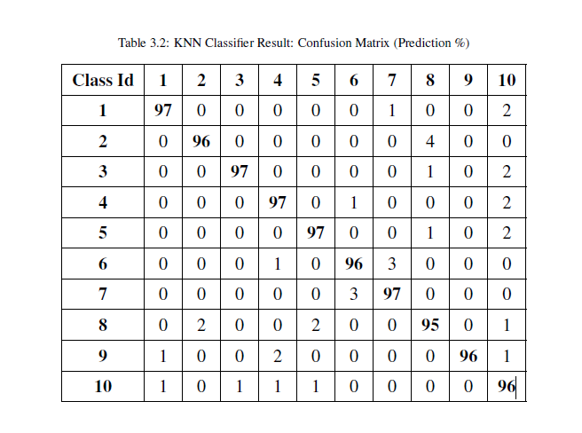
KNN Classification

Slide 16
Conclusion
Explores different degrees of approximation of an object’s contour while varying number of edges of shape approximating polygon .
A special shape encoding scheme has been developed to use popular similarity metric for comparing shape similarity between two objects.
The performance of the proposed scheme is reasonably good and comparable with state-of-the-art algorithms.
We need to further analyze the robustness of the proposed framework.

Slide 17
REFERENCES
S. Marshall, “Review of shape coding techniques,” Image and Vision Computing, vol. 7, no. 4, pp. 281–294, 1989.
D. Zhang and G. Lu, “Review of shape representation and description techniques,” Pattern recognition, vol. 37, no. 1, pp. 1–19, 2004.
M. Hu, “Visual pattern recognition by moment invariants,” IRE Trans. Information Theory, vol. 8, pp. 179–197, 1962.
A. Khotanzad and Y. Hong, “Invariant image recognition by zernike moments,” IEEE Trans. Pattern Analysis and Machine Intelligence, vol. 12, no. 5, pp. 489– 497, 1990.
Y. Kim and W. Kim, “Content-based trademark retrieval system using a visually salient feature,” Image and Vision Computing, vol. 16, no. 12, pp. 931–939, 1998.

Slide 18
THANK YOU

